Slide 1
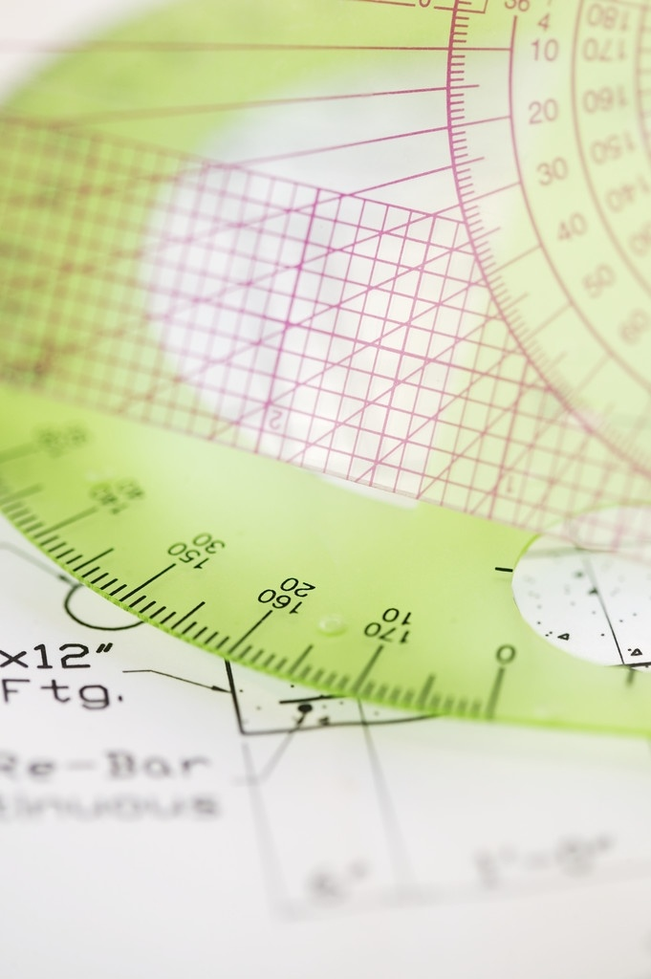


W
Analysis and PDE seminar
연사 | 소속 | 일시 | 장소
안재섭 | 성균관대학교 | 2월 26일 목요일 15시 | 종합과학관 A동 317호
강연 제목
On the radius of analyticity for dispersive partial differential equations and systems
초록
In this talk, we investigate the persistence of spatial analyticity for solutions to a class of nonlinear dispersive equations given initial data that is analytic with a fixed radius. We study the evolution of the uniform radius of analyticity $\sigma(t)$ for all later times $t$, specifically focusing on its asymptotic behaviour as time tends to infinity. It is shown that the spatial analyticity is maintained globally, and we establish explicit algebraic lower bounds on the radius $\sigma(t)$. In particular, we demonstrate that the radius cannot decay faster than a polynomial rate as $|t|\to\infty$. These results are obtained by deriving multilinear estimates in Gevrey-Bourgain spaces and employing an approximate conservation law to control the growth of the solution's Gevrey norm.
관심 있는 모든 분을 환영합니다.
※졸업요건 (수학과 특강) 포함되지 않음
이화여자대학교 종합과학관 A동 문의 : (02) 3277-2290
자연과학대학 수학과

